Slide 1
An Introduction to MCMC for Machine Learning
Pei Jialing
IEEE honor class

Slide 2

What’s MCMC
Markov chain Monte Carlo is a general computing technique that has been widely used in physics, chemistry, biology, statistics, and computer science. It simulates a Markov chain whose invariant states follow a given (target) probability in a very high (say millions) dimensional state space. Essentially, it generates fair samples from a probability which are used for many purposes.

Slide 3
OUTLINE
Motivation & prerequisite
Monte Carlo Integration
Markov chains
MCMC

Slide 4
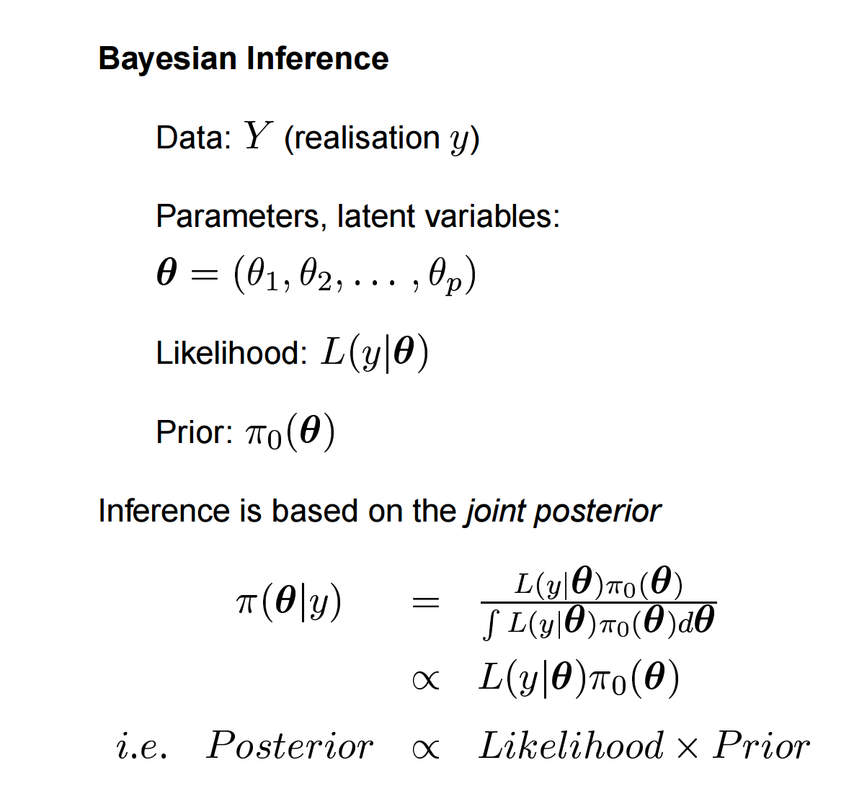
Motivation & prerequisite

Slide 5
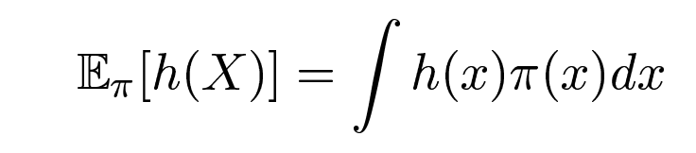
General problem:
Monte Carlo Integration
Given a specific continuous random variable X, we want to evaluate the expectation of X:

Slide 6
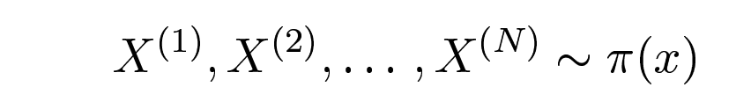
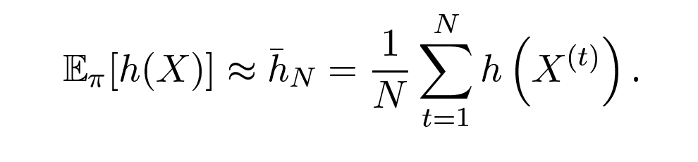
Sol for Monte Carlo (MC) integration
Monte Carlo Integration
This can be very difficult since the function can be very complicated and we cannot simply solve the integration by using traditional methods.
However, if we can draw samples
Then we can estimate

Slide 7
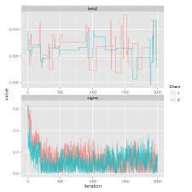
How can we get such samplings?
Markov Chain
Using Markov Chain

Slide 8

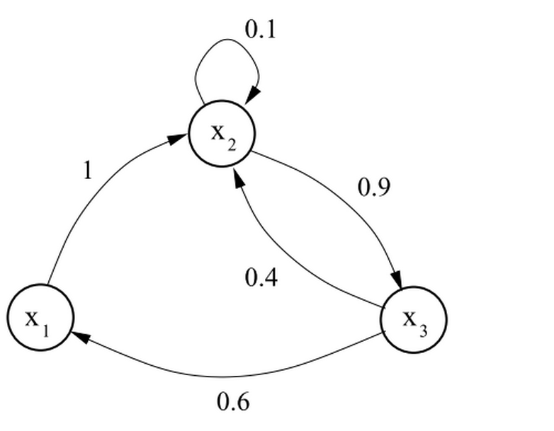
Overall Definition
Markov Chain
Mathematical definition
,where P is the transition kernel. This definition shows the transition relationship inside the state space.

Slide 9
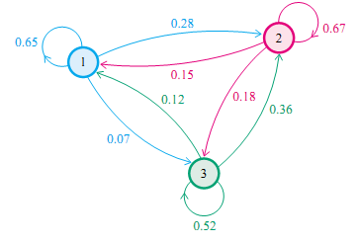
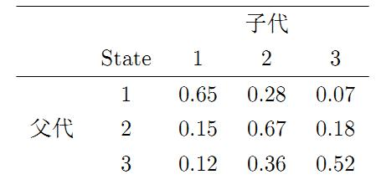
An example
Markov Chain
People can be roughly divided into three classes according to their income situations.

Slide 10
quiz
Markov Chain
If π0 = {0.21,0.68,0.11}, what’s π1?
A: 0.21,0.68,0.11
B:0.252,0.554,0.194
C:0.270,0.512,0.218
D:0.278,0.497,0.225

Slide 11
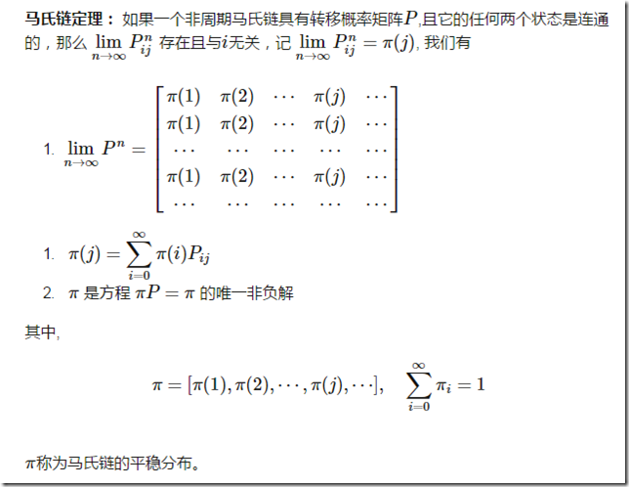
Stationarity
Markov Chain
As t-> ∞, the Markov chain converges to its stationary distribution. Does this happen for all Markov chains?

Slide 12
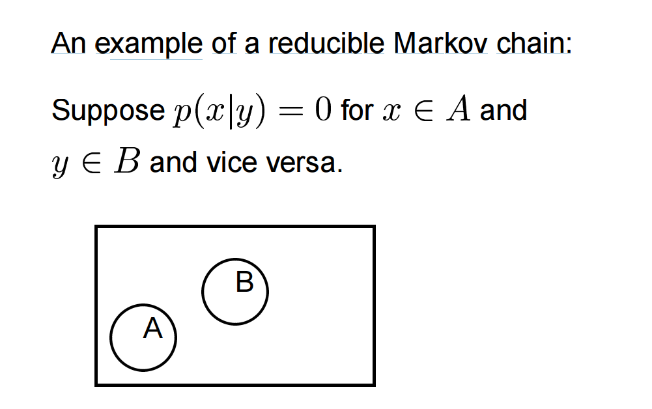
Irreducibility
Markov Chain
Assuming a stationary distribution exists, it is unique if the chain is irreducible.
Irreducible means any set of states can be reached from any other state in a finite number of moves.

Slide 13
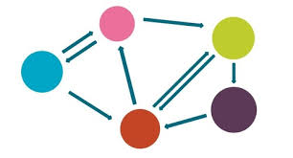
Aperiodicity
Markov Chain
A Markov chain taking only finite number of values is aperiodic if greatest common divisor of return times to any particular state i say, is 1.
Where does this all get us?

Slide 14
MCMC
How do we construct a Markov chain whose stationary distribution is our target distribution, π(x)?
Metropolis et al (1953) showed how the method was generalized. The method is called
Markov chain Monte Carlo (MCMC).

Slide 15
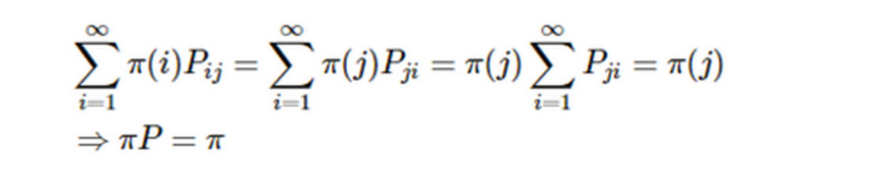
lemma
MCMC
If we have
then we can say that π(x) is a stationary distribution since that:
It is called the detailed balance condition.

Slide 16

MCMC
Difficulty
Let’s suppose that we have a transition matrix Q(q(i,j)), which denotes the probability of the transition from i to j.
It is obvious that in most situations we don’t have the detailed balance condition:
So that p is not a stationary distribution for this Markov chain. What can we do?

Slide 17

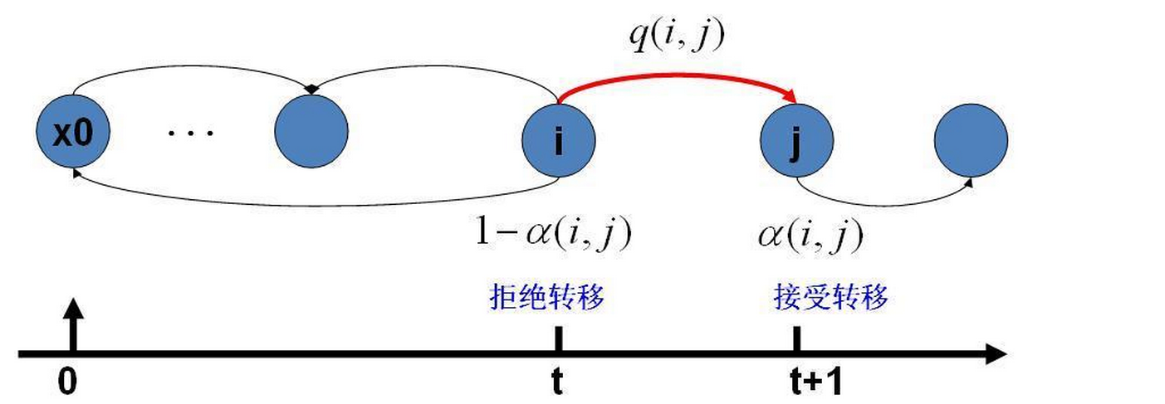
STEP1:use α(i,j)
MCMC
We can construct a parameter α(i,j) so that the detailed balance condition can be satisfied:
where
Besides, we can call α(i,j) acceptance rate .

Slide 18



STEP2:MCMC algorithm
MCMC
At each iteration t:
1.Sample y~q(y|x^{(t)}), where y is the candidate point and q is the proposal distribution
2. sample
3.If , accept the transition from xt to y, which means
4.If u doesn’t satisfy the condition, we don’t accept the transtion.

Slide 19
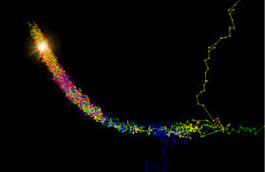
Problem & solution
MCMC
α(i,j) can be very small, so in most cases the transition will be denied and the state will not move on, which means the time for the algorithm to converge is very long.
Solution: Metropolis-Hastings algorithm ! (increase the value of α(i,j) )

Slide 20
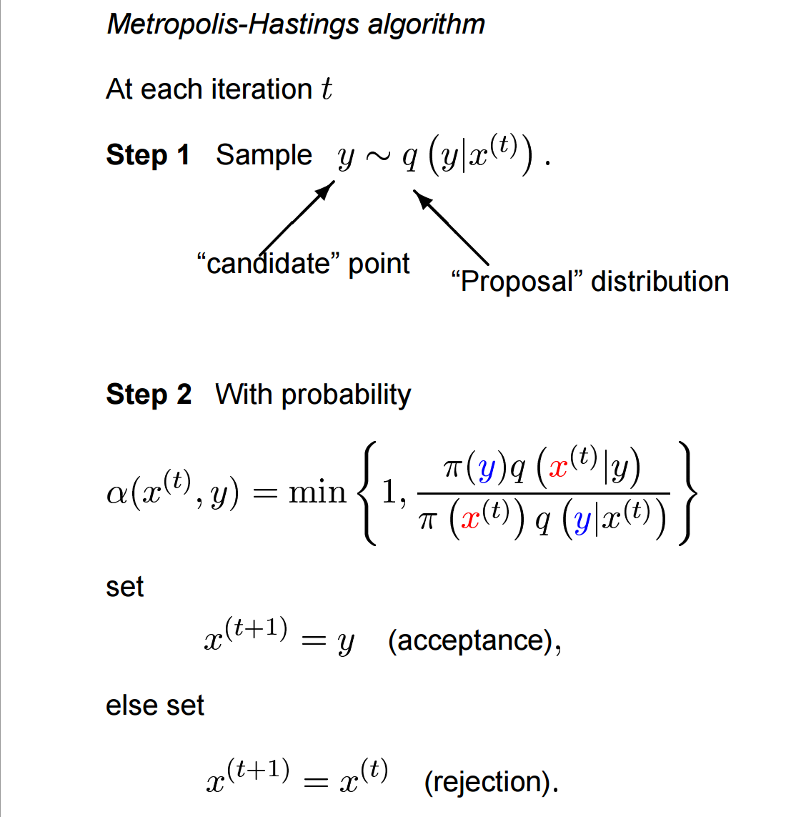
MCMC

Slide 21
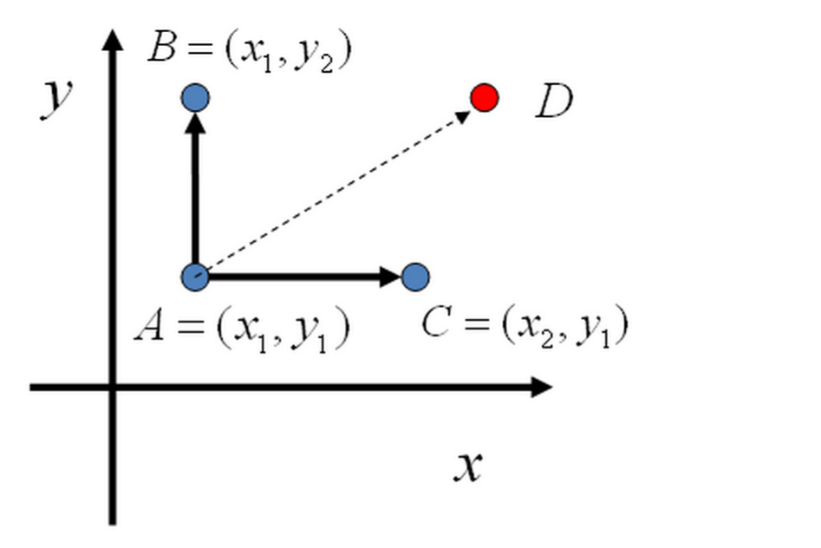
High-dimension improvement: Gibbs sampling
MCMC
Given a two-dimensional probability distribution p(x,y):

Slide 22
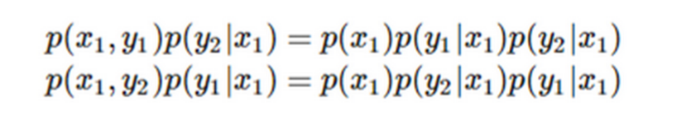


Gibbs sampling
MCMC
Given two points A(x1,y1) and B(x2,y2), it’s easy to find that:
which can lead to the following equation:
Are you familiar with this form?

Slide 23
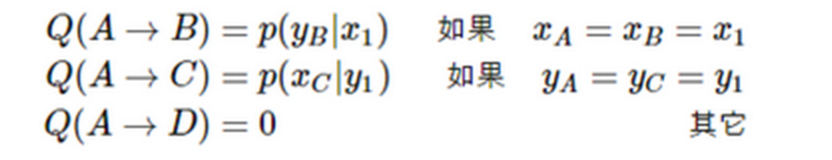
The algorithm
MCMC
1.construct the transition matrix Q:
Then we can demonstrate that for any two points on the plane we have detailed balance condition:

Slide 24
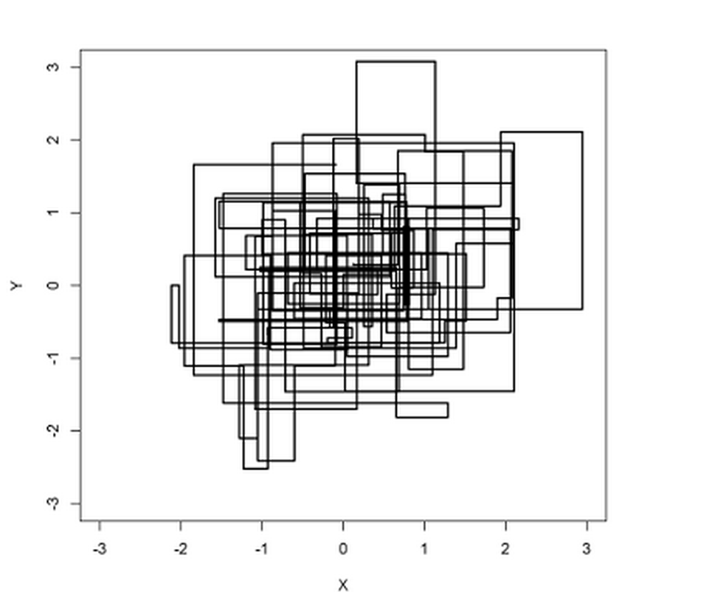
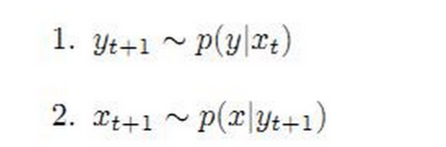
The algorithm
MCMC
2.given x0 and y0
3.for t=0,1,2… sample

Slide 25
Thanks!
Q&A

